Slide 1
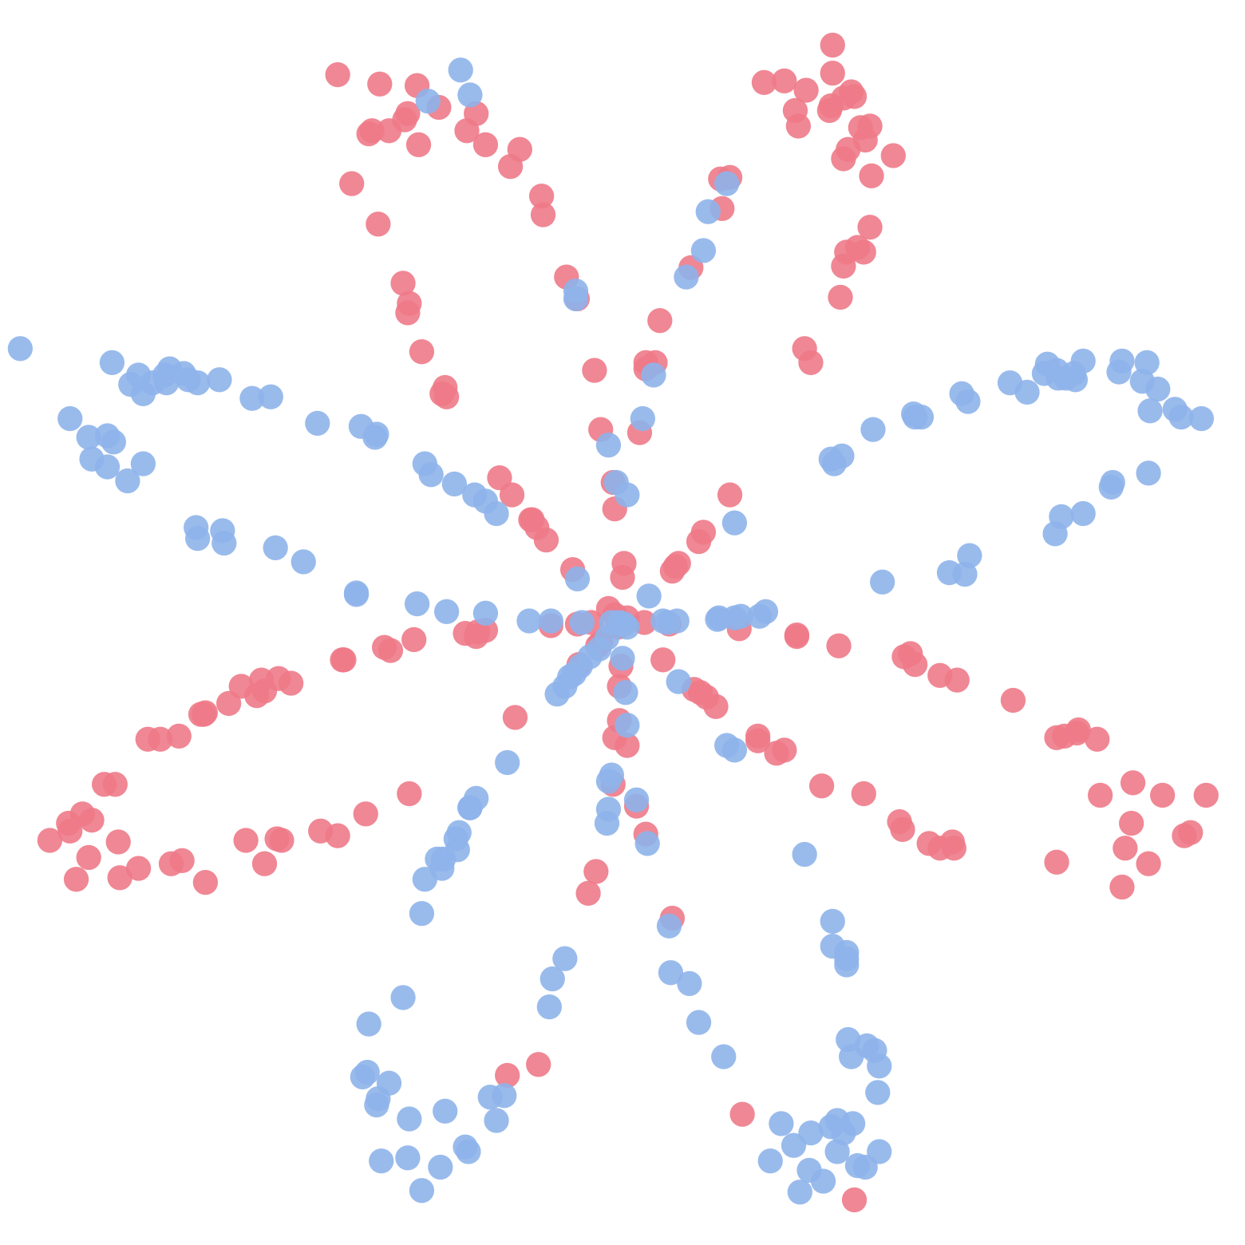
Teaching a network to see a flower
CS4085 DEEP LEARNING · LAB 2
Planar data classification with one hidden layer
Dana Mounayer · Tala Hussien · Hanan Idress
Instructor: Dr. Naila Marir · Effat University
Notes:
Hi everyone. We are Dana, Tala and Hanan. In this lab we built our first neural network from scratch with NumPy. The picture on the right is our actual dataset: 400 points shaped like a flower, and our job was to teach a network to tell the red points from the blue ones.

Slide 2
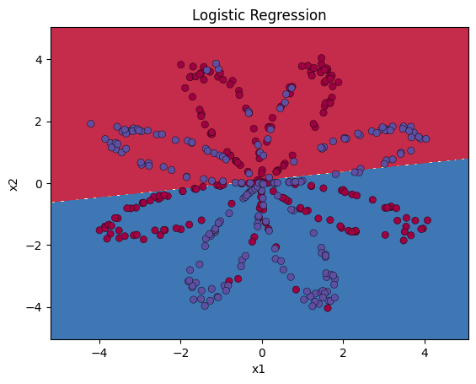
A straight line can't draw petals
1 · THE PROBLEM
400 points shaped like a flower, each red or blue. X is (2, 400), Y is (1, 400).
47%
logistic regression
Worse than a coin flip. We need a model that can bend.
CS4085 Deep Learning · Lab 2 · Dana Mounayer, Tala Hussien, Hanan Idress · 2/8
Notes:
Our data is 400 points shaped like a flower. X holds the two coordinates for each point, Y holds the labels. Logistic regression can only draw one straight line, so it gets 47 percent, worse than guessing. To follow the petals we need a hidden layer.

Slide 3
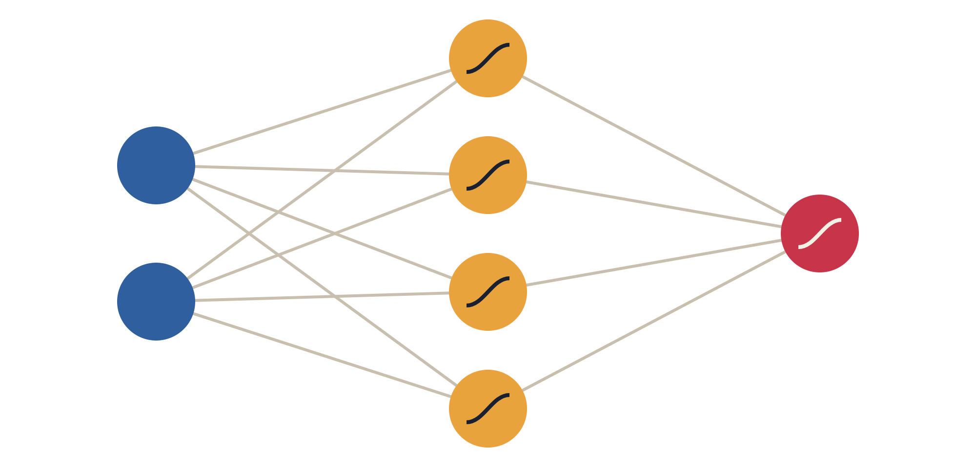
Our network: 2 → 4 → 1
2 · THE MODEL
tanh in the hidden layer lets the boundary curve.
x₁
sigmoid output gives a probability: above 0.5 means blue.
x₂
Weights start small and random to break symmetry.
Input
2 features
Hidden layer
4 units · tanh
Output ŷ
1 unit · sigmoid
CS4085 Deep Learning · Lab 2 · Dana Mounayer, Tala Hussien, Hanan Idress · 3/8
Notes:
Two inputs, four hidden neurons with tanh, one output with sigmoid. tanh is what lets the boundary bend. The sigmoid gives a probability, and above 0.5 we say blue. We start the weights as small random numbers: if they were all zero, every hidden neuron would learn the same thing.

Slide 4

One loop, four steps
3 · HOW IT LEARNS
REPEAT 10,000 TIMES
1
2
3 · OUR FOCUS
4
Forward
Cost
Backward
Update
Make a guess
How wrong?
Who's to blame?
Fix the weights
Data flows left → right; A2 = probability
Cross-entropy; starts at 0.693, a coin flip
A gradient for every weight
θ = θ − α·dθ, with α = 1.2
CS4085 Deep Learning · Lab 2 · Dana Mounayer, Tala Hussien, Hanan Idress · 4/8
Notes:
Training is one loop. Forward: the data goes left to right and comes out as a probability. Cost: cross-entropy scores how wrong we are; it starts at 0.693, the cost of guessing 50/50. Backward: find which weights caused the error. Update: move each weight a small step against its gradient. Repeat ten thousand times. The backward step is our focus.

Slide 5

Send the error backwards, output to input
4 · BACKPROPAGATION
1 · OUTPUT
2 · HIDDEN
3 · WEIGHTS
Measure the error
Pass it back
Get gradients
dZ2 = A2 − Y
dZ1 = W2ᵀdZ2·(1−A1²)
dW = dZ·inputᵀ / m
Prediction minus truth.
Share the blame. (1−A1²) is tanh's slope.
How much each weight should change.
CS4085 Deep Learning · Lab 2 · Dana Mounayer, Tala Hussien, Hanan Idress · 5/8
Notes:
Backprop answers: which weights caused the error, and by how much? One: at the output, the error is prediction minus truth. Two: pass it back to the hidden layer through W2, multiplied by the slope of tanh, 1 minus A1 squared. That shares the blame among the hidden neurons. Three: each layer's weight gradient is its error times its input, averaged over all examples; the bias gradient is the average error.

Slide 6
Six lines do all the work
5 · BACKPROP IN CODE
“Output first, then hidden.”
OUR CODE
Each layer: get its error dZ, then its gradients dW and db.
# output layer
dZ2 = A2 - Y
dW2 = (1 / m) * np.dot(dZ2, A1.T)
db2 = (1 / m) * np.sum(dZ2, axis=1, keepdims=True)
# hidden layer
dZ1 = np.dot(W2.T, dZ2) * (1 - np.power(A1, 2))
dW1 = (1 / m) * np.dot(dZ1, X.T)
db1 = (1 / m) * np.sum(dZ1, axis=1, keepdims=True)
Reuses A1 and A2 from the forward cache and handles all 400 examples at once, with no loops.
CS4085 Deep Learning · Lab 2 · Dana Mounayer, Tala Hussien, Hanan Idress · 6/8
Notes:
Here are those three moves in our code. Output layer first: the error, then weight and bias gradients. Then the hidden layer with the same pattern. One over m averages over the 400 examples, and the forward cache gives us A1 and A2 so nothing is recomputed.

Slide 7

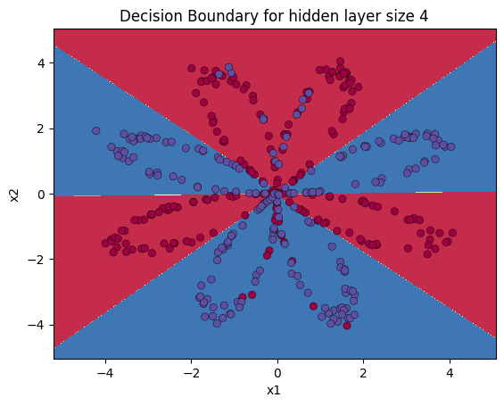
From 47% to 90%, and what we tuned
6 · RESULTS
47%
90%
Hidden units
Learning rate
1
67%
0.01
57%
5
91%
1.2
90%
50
90%
10
jumpy
Bigger isn't always better: too many units overfit.
Too small is slow; too big overshoots.
CS4085 Deep Learning · Lab 2 · Dana Mounayer, Tala Hussien, Hanan Idress · 7/8
Notes:
Our 4-unit network got 90 percent, versus 47 for logistic regression, and the boundary follows the petals. We also tuned two things. Hidden units: 1 is too simple, 5 was best at about 91 percent, 50 starts to overfit. Learning rate: 0.01 barely learns, 1.2 is smooth, and 10 makes the cost spike. On the noisy moons dataset the network also beat logistic regression, 99 versus 85 percent.

Slide 8
Three things to remember
7 · KEY TAKEAWAYS
01
02
03
A hidden layer bends the boundary
Backprop finds the blame
Gradient descent fixes it
The error flows right → left to give every weight a gradient.
Step against the gradient, 10,000 times.
tanh took us from 47% to 90%.
Thank you! Questions?
Dana Mounayer · Tala Hussien · Hanan Idress
Notes:
To wrap up: the hidden layer is what makes curved boundaries possible; backprop sends the error backwards to compute every gradient; and gradient descent uses those gradients to improve the weights. Thank you, we're happy to take questions.

